Slide 1
Identifying an Apartment in a Manhattan, NY Neighborhood with Similar Amenities as my Current Neighborhood
Coursera Capstone Project:
“Battle of the Neighborhoods”
Q. Jafri
January 8, 2021

Slide 2
1. Introduction
Background I am currently living in Downtown San Jose, CA within walking distance of “Dirdon Train Station”. My neighborhood is full of great venues and attractions such as international cuisine, entertainment, and shopping. Recently, I received an offer to move to Manhattan, NY for a new job that I would like to accept, and I want to move to a neighborhood that offer’s similar options as my current residence. For reference, Manhattan office is located at Park ave and 53rd street.
Problem Identify an apartment in Manhattan, NY with the following criteria: -Min. 2 bedrooms -Monthly rent not to exceed US$7000/month -Walking distance to a subway station (defined as <=1.0 mile, 1.6 km) -Similar venues and attractions to my current neighborhood in San Jose, CA
Interest The methodology, tools and strategy used in this project will be relevant for any person or people considering moving and who would like to do a deep dive on the amenities of various neighborhoods in the new location compared to their own prior to moving. This strategy can also be useful in exploring perspective neighborhoods for opening of a new business.

Slide 3
2. Data Acquisition and Cleaning
Data Requirements -Geodata for current neighborhood in Downtown San Jose via Foursquare API -List of Manhattan, NY neighborhoods with clustered venues via Foursquare API -List of subway stations in Manhattan, NY with addresses and geodata -List of apartments for rent in Manhattan, NY with neighborhoods, address, geodata, number of bedrooms, area size, and monthly rent. -New job location in Manhattan for reference
Data Sources Downtown San Jose and Manhattan, NY neighborhoods data attained via Fousquare. Lists of subway stations in Manhattan are available from Wikipedia and Google maps. A list of apartments for rent was consolidated from web-scraping real estate sites for Manhattan (site 1, site 2).
Data Processing Neighborhood maps were created using the data sourced from Foursquare, Nominatim and Folium mapping. Following web scraping of various rental websites, available apartment’s geodata were found with algorithm coding and using Nominatim. Finally, Folium was used to consolidate all data into a final single map where one can visualize all details needed to make a selection of an apartment.

Slide 4
3. Methodology
Strategy Data described in section 2.0 will be mapped and the resulting map will be used to identify potential rentals in Manhattan, NY. As described in section 2.0 data will be consolidated into a single map where details of various rental options along with clusters of neighborhood venues and attractions as well as the relative location of said rentals to subway stations will be presented. A measurement tool icon will also be provided and the popups on the map items will display rent price, location and cluster of venues and attractions as appropriate.
Tools Web-scraping of various rental websites, wikipeida, and Google maps will be used to consolidate data-frame information. This infromation will be saved as a CSV file for ease of use and to simplify the report. Geodata was obtained by coding for the use of Nomnatim to get latitdue and longitude of subway stations and rental apartments in Manhattan, NY. Geopy_distance and Nominatim were used to establish relative distances and Seaborn graphic was used for general statistics on rental data.

Slide 5
4. Data Analysis

Slide 6
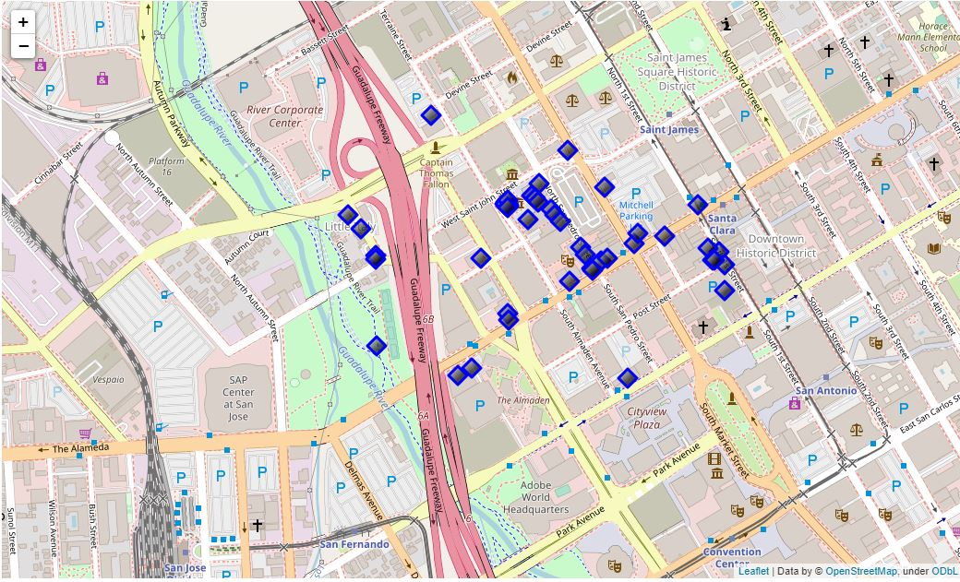
4.1 Current Neighborhood – San Jose, CA

Slide 7
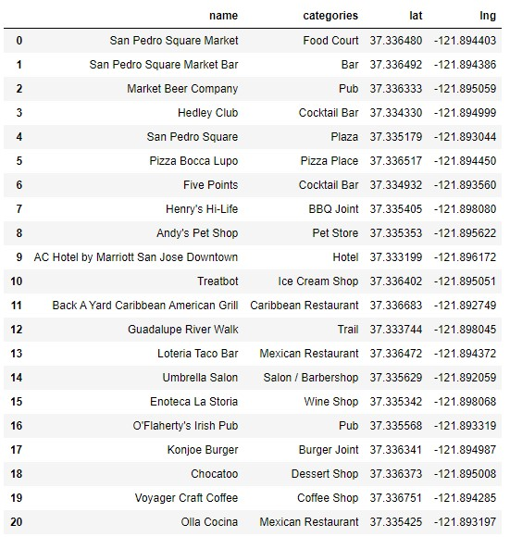
4.2 Venues Near Current Residence – San Jose, CA

Slide 8
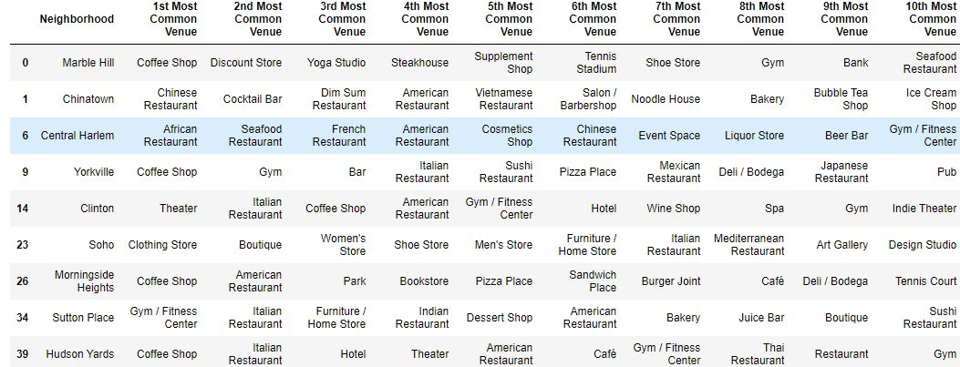
4.3 Neighborhood Cluster Tables - Manhattan, NY (Cluster 2 shown)

Slide 9
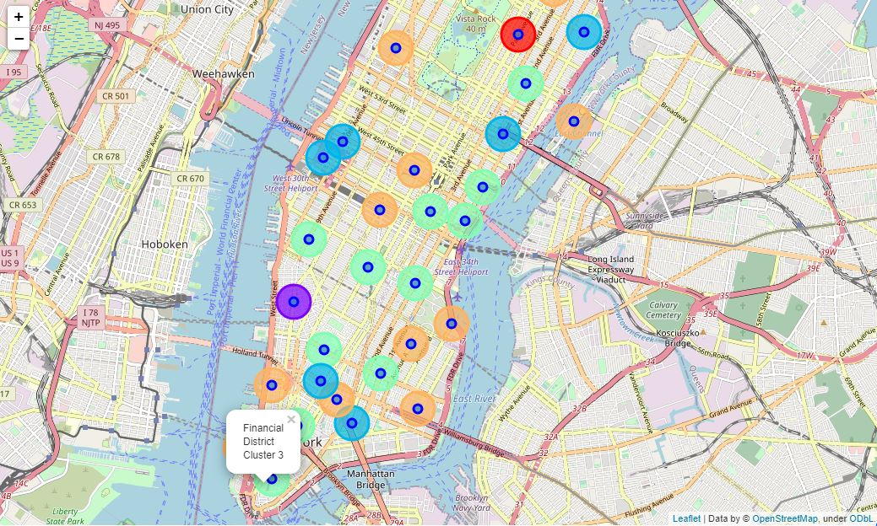
4.4 Neighborhood Clusters Map -Manhattan, NY

Slide 10
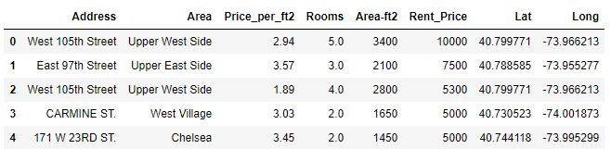
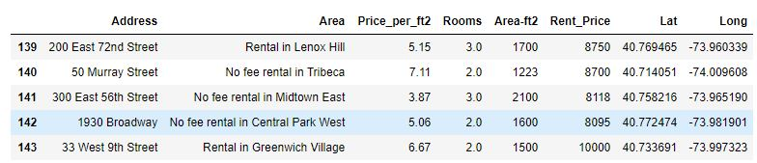
4.5 Apartments for Rent GeoData – Manhattan, NY (Head and Tail tables)

Slide 11
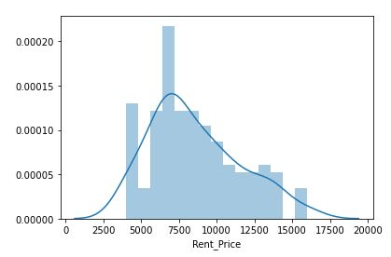
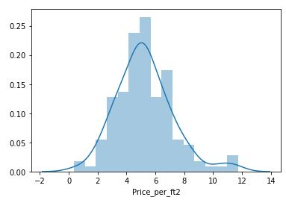
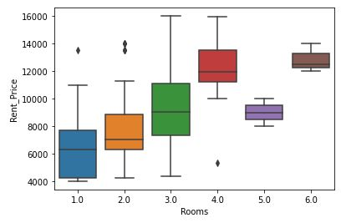
4.6 Apartment Rental Price Statistics – Manhattan, NY
Rent Price Distribution
Rent Price per Square Feet Distribution
Rent Price vs Bedroom

Slide 12
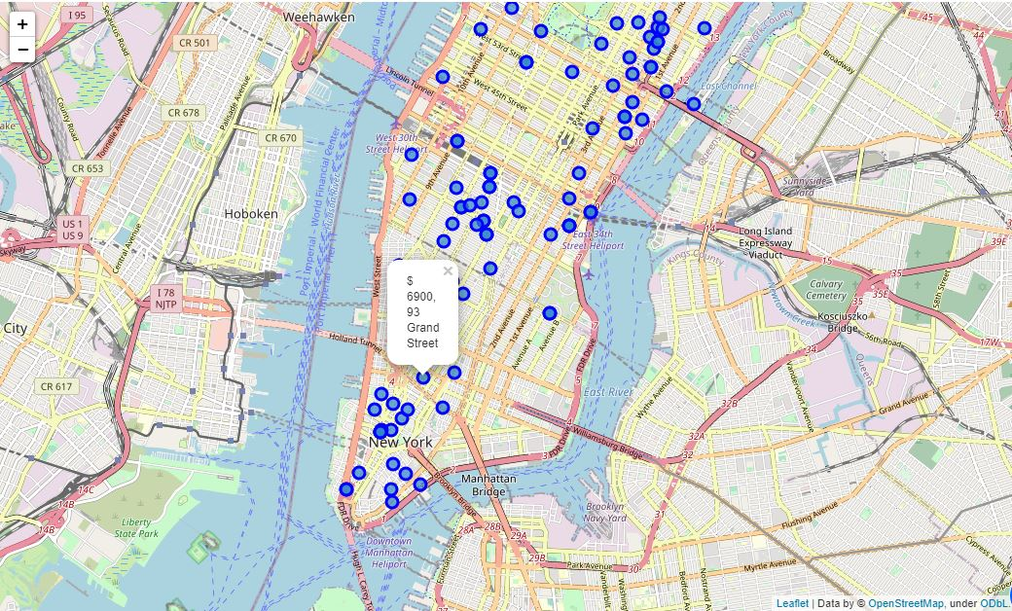
4.7 Apartments for Rent - Manhattan, NY

Slide 13
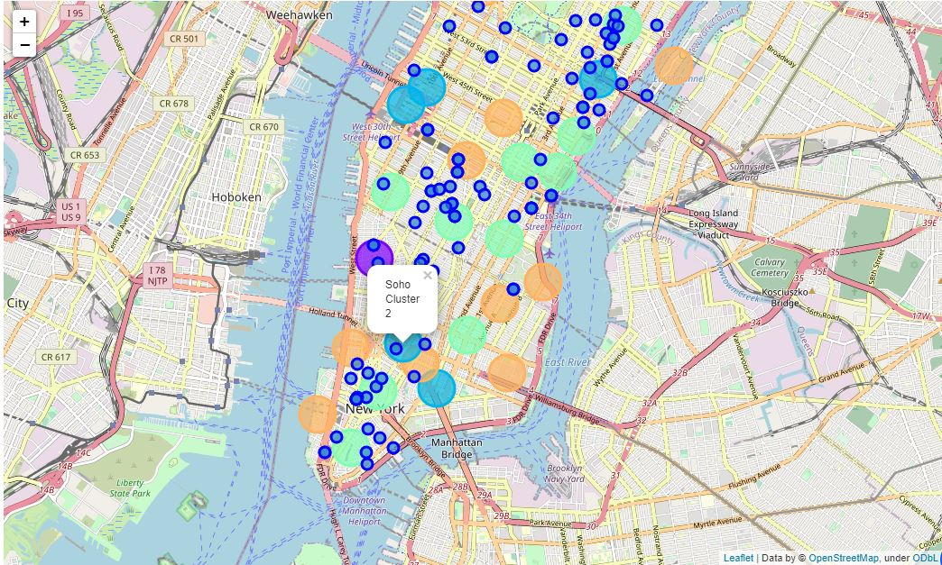
4.8 Apartments for Rent with Neighborhood Clusters – Manhattan, NY

Slide 14
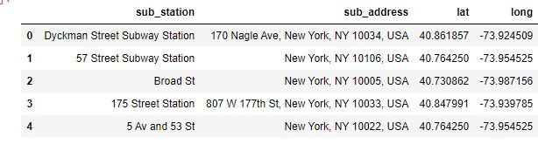
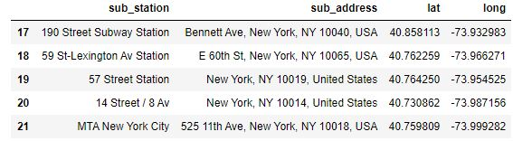
4.9 Subway Stations Geodata -Manhattan, NY (Head and Tail Tables)

Slide 15
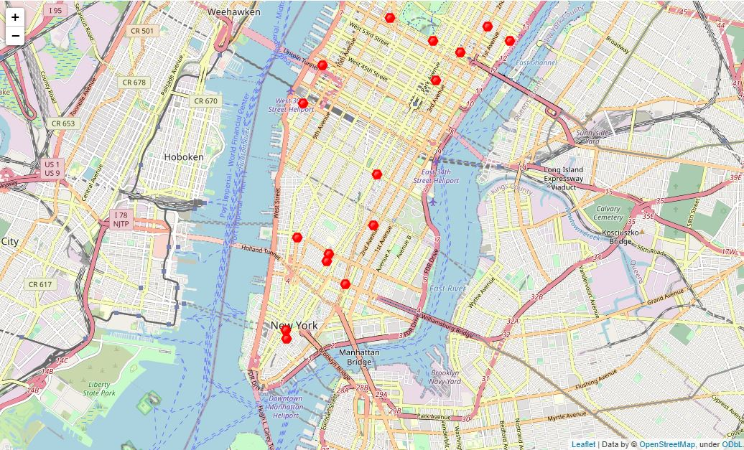
4.10 Subway Stations Map – Manhattan, NY

Slide 16
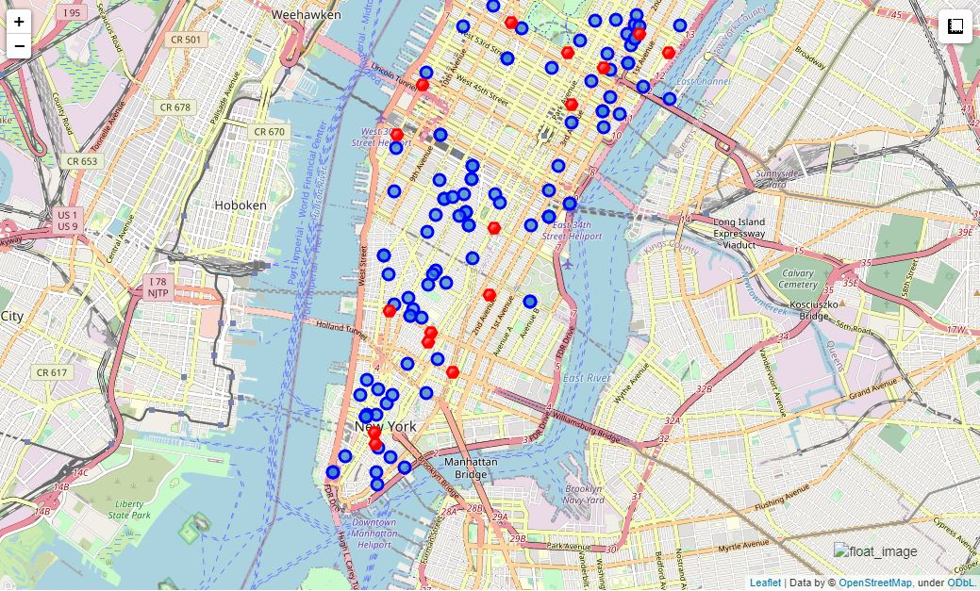
4.11 Apartments (Blue) and Subway Stations (Red) Map - Manhattan, NY

Slide 17
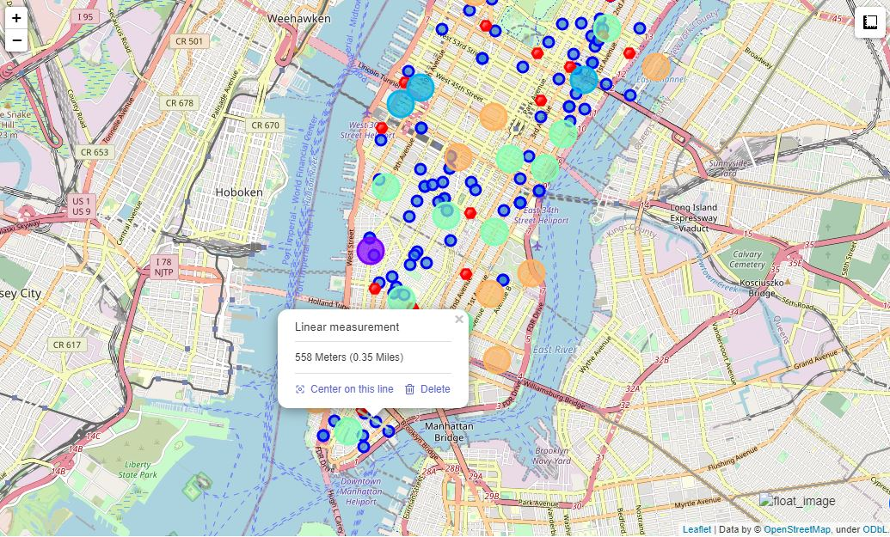
4.12 Final Consolidated Map – Manhattan, NY (w/ measurement tool)

Slide 18
5. Results

Slide 19
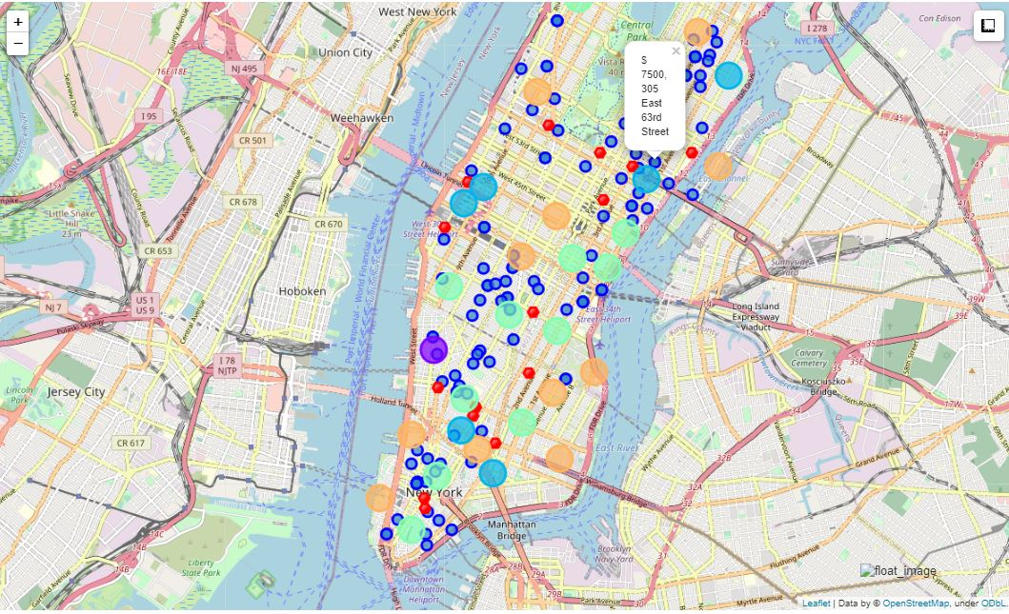
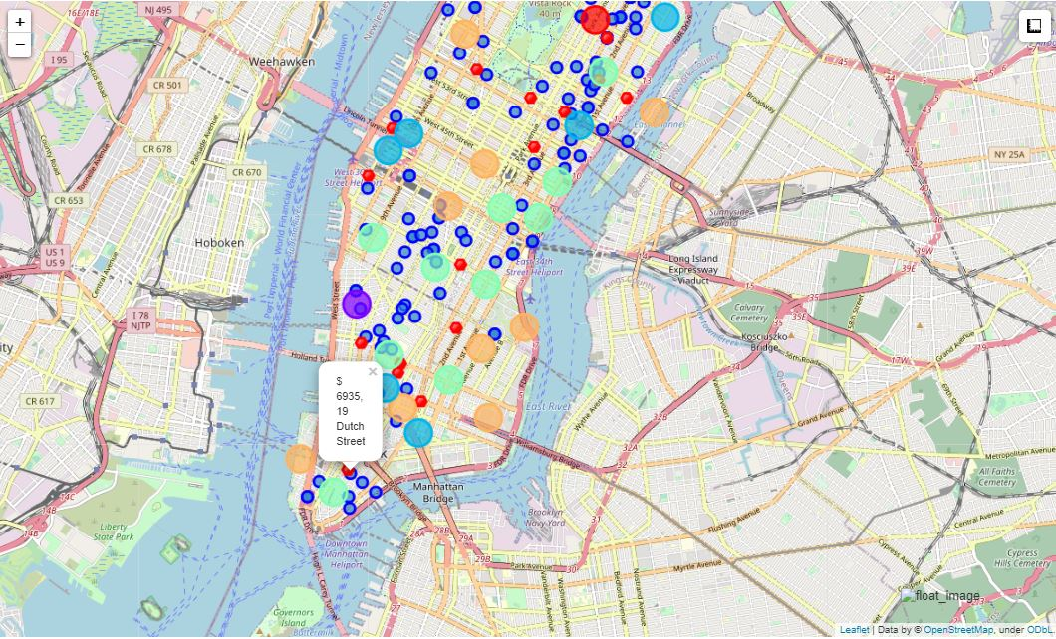
5.1 Apartment Candidates:
Using the final consolidated map (4.12) I was able to identify two potential apartments
Apartment 1: 305 East 63rd street in the Sutton Place Neighborhood (Type: Cluster 2) near the 59th street subway station. Monthly rent of $7500, walkable to work.
Apartment 2: 19 Dutch Street in the Financial District Neighborhood (Type: Cluster 3) near the Fulton Street subway station. Monthly Rent of $6935, would need to ride the subway to work (~40 mins round trip).

Slide 20
5.2 Identifying My Preferred Neighborhood Type (Cluster)
Using the Venue Cluster tables (see section 4.3) I was able to compare and contrast each of generated clusters to my current residence venue table.
After reviewing each cluster, I decided to choose cluster 2 (blue) as an ideal neighborhood preference for me.
Based off the cluster 2 venues table (see section 4.3) there are nine neighborhoods which would be similar to my current neighborhood.

Slide 21
6. Discussion
Final Apartment selection
After careful consideration, I decided to move forward with Apartment 1 (see 5.1) for two primary reasons.
First, it is near the Sutton Place neighborhood, which is my preferred cluster 2 type.
Secondly, it is preferred as it is only 0.6 miles to work meaning I can walk to work every day and not have to rely on the subway transit system.
Of Note, the downside of Apartment 1 is that it is $500 above my preferred budget but I think the added expense is justified given its proximity to my new office and the added quality of life benefit.
Although Apartment 2 is more affordable and conveniently located near a subway station, this location would require a daily commute of 40 or more minutes roundtrip to work via the subway system. It is also near the financial district neighborhood, which is a cluster 3 type neighborhood instead of my preferred cluster 2, and thus I do not think this is a great fit for me.

Slide 22
7. Conclusion
I was able to rapidly identify a suitable apartment for my needs and even though it was above my original budget I felt justified in it’s selection based off my neighborhood cluster analysis and proximity to my future office site.
The code I used to perform my analysis and generate my detailed maps can be used to map and perform a similar analysis for any two locations as long as GeoData is attainable.
This analysis can also be useful for potential business owners who want to understand specific neighborhood dynamics before opening up a location in said neighborhood.

